Slide 1
COMP 3500 Introduction to Operating Systems Project 5 – Virtual Memory Manager Part 1: Overview
Dr. Xiao Qin
Auburn University http://www.eng.auburn.edu/~xqin
xqin@auburn.edu
Notes:
Lecture 39
Fall’17: 30-35 Minutes, slides 1-19.
Slides 19-33 to be continued in Lecture 40
Spring’17: Only 30 Minutes: slides 1-15
Fall’16: 50 Minutes: slides 1-29

Slide 2
COMP3500 Students
Project 4 System Calls

Slide 3
COMP3500 Students Defeated Project 4

Slide 4
Project 5 Virtual Memory Manager
COMP3500 Students

Slide 5
Learning Objectives
Virtual Memory
TLB faults
To Implement a C or C++ program dealing TLB faults.
To design a simple virtual memory system
Performance Tuning
Debugging Skills
To tune your TLB and memory replacement algorithms.
Use GDB to debug your C program

Slide 6
Your Mission
Loading
Translating Address
Output Values
load a file containing
a list of logical
addresses
translate logical
addresses into
physical addresses
output the value of
the byte stored at
the translated
physical address.

Slide 7
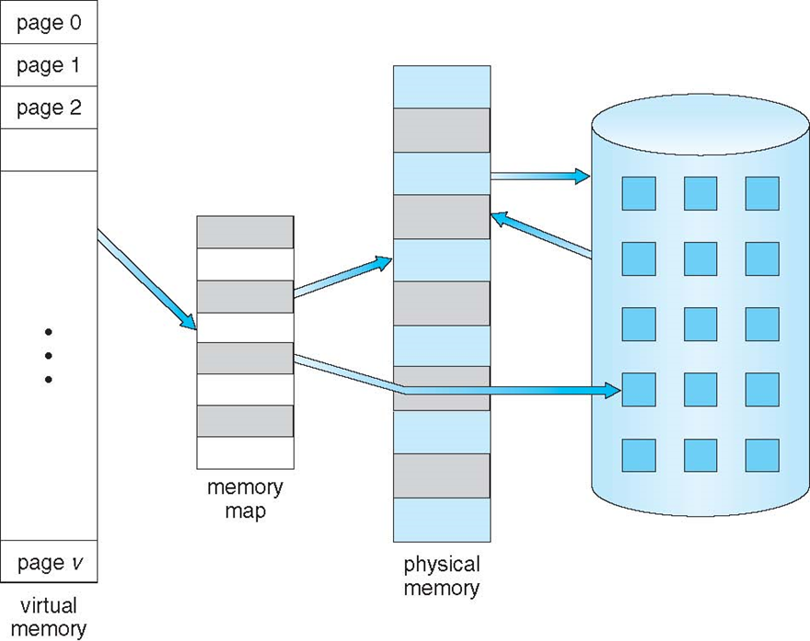
Basic Idea of Virtual Memory: Virtual Memory is Larger Than Physical Memory

Slide 8
16-bit Logical Addresses

Slide 9
⬇⬇⬇ Exercise 1 (Plickers): System Parameters
Page table size: 2⁸
Number of TLB entries: 16
Page size: 2⁸ bytes
Physical memory size: 64 KB
Frame size: 2⁸ bytes
How many frames are there?
A. 16
B. 64
C. 128
D. 256

Slide 10
⬇⬇Exercise 2 (Plickers): System Parameters
Page table size: 2⁸
Number of TLB entries: 16
Page size: 2⁸ bytes
Physical memory size: 64 KB
Frame size: 2⁸ bytes
How large is the logical memory space?
A. 256 Bytes
B. 32K Bytes
C. 64K Bytes
D. 128K Byte
Notes:
65,536 bytes

Slide 11

A Paging System with Translation Look-aside Buffers (TLB)

Slide 12
Address Translations: An algorithm
Step 1: page number is extracted
from the logical address.
If TLB-hit,
the frame number of
the page is obtained
from the TLB.
Step 2: Access the TLB using
the extracted page number.
If TLB miss,
follow step 3 to access
the page table.
If the page has been loaded
into the main memory,
the frame # of the page is
obtained from the page table
Step 3: Access the page table
Otherwise,
a page fault occurs.

Slide 13
⬇⬇⬇ Exercise 3: What are the three key data structures in the paging system?
Page Table
TLB
Physical memory

Slide 14

⬇⬇⬇ Exercise 4 (Plickers): A Question about Page Faults
A user program tries to access data at virtual address X. Which one of the following conditions will never arise?
A. TLB miss, page fault
B. TLB miss, no page fault
C. TLB hit, page fault
D. TLB hit, no page fault
Notes:
If the situation cannot happen, answer "impossible" and explain why it cannot occur.
TLB miss, page fault
TLB miss, no page fault
TLB hit, page fault
TLB hit, no page fault

Slide 15
Handling Page Faults
You should implement demand paging
The backing store is simulated by a file called “BACKING_STORE”
BACKING_STORE is a binary file of 65,536 bytes.
Notes:
You must implement demand paging in the simulated virtual memory system. The backing store is simulated by a file called “BACKING_STORE”, which is available on the Canvas system. BACKING_STORE is a binary file of 65,536 bytes. When a page fault ocrrurs, your virtual memory system will perform the following four steps:
Step 1: read a 2560byte page from the file BACKING_STORE and
Step 2: store the loaded page frame in the physical memory.
Step 3: Update the page table
Step 4: Update the TLB

Slide 16
Backing_Store vs. Virtual Memory
BACKING_STORE is a simulated hard drive in your system.

Slide 17
Handling Page Faults
Step 1: read a 256-byte page from
file BACKING_STORE.
Step 2: store the loaded page
frame in the physical memory
Step 3: Update the page table
Step 4: Update the TLB
Notes:
When a page fault occurs, your virtual memory system will perform the following four steps:
Step 1: read a 2560byte page from the file BACKING_STORE and
Step 2: store the loaded page frame in the physical memory.
Step 3: Update the page table
Step 4: Update the TLB

Slide 18
Accessing BACKING_STORE
BACKING_STORE is a simulated hard drive in your system.
BACKING_STORE is accessed as a random-access file:
your VM system can randomly seek to certain positions to this file for reading pages from the simulated disk.
Use the standard C library functions for performing file reads, including fopen(), fread(), fseek(), and fclose().
In a future lecture, I will show you how to use the standard C library functions to access BACKING_STORE.
Notes:
One of your group members needs to implement functions to move a page from the simulated disk to physical memory. Note that BACKING_STORE is a simulated hard drive in your system.
It is worth mentioning that the file BACKING_STORE is accessed as a random-access file, where your virtual memory system can randomly seek to certain positions to the file for reading pages from the simulated disk. You are suggested to use the standard C library functions for performing file reads, including fopen(), fread(), fseek(), and fclose().
Important! In one of our lectures related to this project, we will show you how to use the standard C library functions to access BACKING_STORE.

Slide 19
⬇⬇ Exercise 5 (Plickers): No Page Replacement
Your VM system does NOT need to deal with the page replacement issue. Why?
The physical memory size equals to the virtual address space.
Notes:
Your system does not need to deal with the page replacement issue, becuause the physical memory size equals to the virtual address space. In other words, during the page fault process, no page will be invicted from the physical memory.

Slide 20
The First Step
To understand how TLB and page faults occur.
Task 1:
study TLB faults
Task 2:
should study page faults
Discuss design issues with
your group members
Notes:
The first step is understanding how TLB and page faults occur. You should expect to spend a substantial amount of time reading and learning the concepts of paging and TLB. Therefore, it is suggested that one group member should study TLB faults and one group member should study page faults.

Slide 21
Discuss key issues
What will your page tables look like?
What should you put in each PTE (page table entry)?
In what order can TLB faults and page faults occur? (e.g., can a page fault occur without causing a TLB fault?)
Review each other's designs.
Notes:
Your group members should discuss the following key issues before moving on are:
What will your page tables look like?
What should you put in each PTE (page table entry)?
In what order can TLB faults and page faults occur? For example, can a page fault occur without causing a TLB fault?
Do your best to break your group member's implementation, then help him/her fix it. When you write test programs, think about verifying that your TLB replacement algorithms are working correctly (i.e., "If I run this program it should generate exactly n TLB faults with your algorithm; does it?").
Review each other's designs. Think about how you might have implemented the different parts and compare ideas. As your system begins to stabilize, begin to work on the performance tuning. Continue to test and fix bugs. Take turns testing and tuning. Be sure to keep a careful log of your performance experiments so you can trade it back and forth.

Slide 22
Time Management
⬇⬇⬇⬇ Exercise 6 (Plickers): Which requires more time to implement?
A. page fault handling B. TLB fault handling.
Page fault handling is more difficult to implement than TLB fault handling!
Divide VM implementation into several small and well-defined modules
Get together as early as possible to share what you each have discovered and designed.
Notes:
Due to file I/O. You have to work closely with your group members on this project. The time required to implement page fault handling is longer than the time required to implement TLB fault handling. You should divide the virtual memory implementation into several small and well-defined modules so that you can both work on it as soon as one of you has completed the TLB implementation. Get together as early as possible to share what you each have discovered.
When you have completed your initial implementation of the TLB and virtual memory, your group can partition the tasks as follows:
Group member 1: work performance tuning. Please refer to Section 7.2 on page 7 for details on performance evaluation.
Group member 2: Assist group member 1 and write a performance evaluation report.
Group member 3: work on separate compilation and prepare a makefile. Please refer to Section 8 on page 7.

Slide 23
Implementation Idea: Extracting Page Numbers and Offset
Implement and test a function to extract page number and an offset from the following addresses:
1, 256, 32768, 23769, 128, 65534, 33153
Use bit-masking and bit-shifting operators.
Then integrate this function into your simulated VM System.
Notes:
Write a function is to extract page number and an offset from the following addresses:
1, 256, 32768, 23769, 128, 65534, 33153
A straightforward way of extracting page number and offset is to use bit-masking and bit-shifting operators. After you fully implement and test this function, you can integrate this function into your simulated virtual memory system.

Slide 24
Implementation Idea: Page Table
Before implement the TLB, you are suggested to implement a page table.
⬇⬇⬇⬇ Exercise 7 (Plickers): Why we want to make sure our system has a functional page table prior to the development of the TLB?
A. The VM system can run without a hard drive
B. The VM system can run without a page table
C. The TLB can run without a page table
D. The VM system can run without a TLB
The VM system can run without a TLB, the goal of which is to improve the system performance.
Notes:
Your system must handle page faults using the TLB and the page table. Before implement the TLB, you should focus on the implementation of a page table. Please make sure your system has a functional page table prior to the development of the TLB. This strategy is feasible, because your system can perform without a TLB, the goal of which is to improve the performance of a virtual memory system.

Slide 25
The TLB and Paging Modules
Your system must handle page faults using the TLB and the page table.
Task 2:
Implement TLB
Task 1:
Implement Paging
Integrate these
two modules together
Notes:
The first step is understanding how TLB and page faults occur. You should expect to spend a substantial amount of time reading and learning the concepts of paging and TLB. Therefore, it is suggested that one group member should study TLB faults and one group member should study page faults.

Slide 26
Implementation Idea: TLB and its Replacement Strategy
TLB has a total of 16 entries
Implement two replacement strategies:
The TLB state should be initialized properly.
FIFO (i.e., First In and First Out).
The LRU (i.e., Least Recently Used) strategy to optimize the TLB hit rate.
Notes:
Your system must handle page faults using the TLB and the page table. Before implement the TLB, you should focus on the implementation of a page table. Please make sure your system has a functional page table prior to the development of the TLB. This strategy is feasible, because your system can perform without a TLB, the goal of which is to improve the performance of a virtual memory system.

Slide 27
What you don’t have to implement?
You do NOT have to implement a replacement strategy for the page table.
You do NOT need to take care of context switch, because there is no process manager in your system.
You do NOT have to worry about the kernel.
You do NOT have to read OS/161 source code.
Notes:
Please keep in mind that this project will not be build on top of OS/161. You don’t have to implement a handful of components of an operating system. In particular, you can ignore the following items while implementing your system.
You do NOT have to implement a replacement strategy for the page table.
You do NOT need to take care of context switch, because there is no process manager in your system.
You do NOT have to worry about the kernel.
You do NOT have to read OS/161 source code.

Slide 28
Testing File
InputFile.txt:
Test your simulated virtual memory system.
Download this file from the Canvas system
The file contains:
A list of integers representing logical addresses
Ranging from 0 to 65,535
Virtual address space.
You program must
read all the logical addresses stored in this file,
translate the addresses into corresponding physical addresses, and
output the value of the singed byte at the physical address.
Notes:
A testing file named InputFile.txt will be provided to you to test your simulated virtual memory system. This testing file is available on Canvas system. The file contains a list of integers representing logical addresses ranging from 0 to 65,535, which is the virtual address space. You program must (1) read all the logical addresses stored in this file, (2) translate the addresses into corresponding physical addresses, and (3) output the value of the singed byte at the physical address.
A small test input file called testinput.txt can be downloaded from Canvas to test your implementation.

Slide 29
A Small Testing File
A small test input file called testinput.txt can be downloaded from Canvas to test your implementation.
Notes:
A testing file named InputFile.txt will be provided to you to test your simulated virtual memory system. This testing file is available on Canvas system. The file contains a list of integers representing logical addresses ranging from 0 to 65,535, which is the virtual address space. You program must (1) read all the logical addresses stored in this file, (2) translate the addresses into corresponding physical addresses, and (3) output the value of the singed byte at the physical address.
A small test input file called testinput.txt can be downloaded from Canvas to test your implementation.

Slide 30
Performance Tuning
Use the file vm_sim_output.txt as your "lab notebook" for this section.
Implement some software counters:
The number of page faults.
The number of TLB faults.
Experiment with different TLB replacement strategies (i.e., FIFO and LRU)
Tune system parameters
Notes:
Now we pay our attention to the issue of performance evaluation for your virtual memory system. Please use the file vm_sim_output.txt as your "lab notebook" for this section. You will undoubtedly want to implement some additional software counters. As a start, we suggest:
The number of page faults.
The number of TLB faults.

Slide 31
Programming Environment
Write your simulated virtual memory system in either C or C++.
Compile and run your system using the gcc or g++ compiler on a Linux box (either in Shop 3, computer labs in Shelby, your home Linux machine, a Linux box on a virtual machine, or using an emulator like Cygwin).
Notes:
Now we pay our attention to the issue of performance evaluation for your virtual memory system. Please use the file vm_sim_output.txt as your "lab notebook" for this section. You will undoubtedly want to implement some additional software counters. As a start, we suggest:
The number of page faults.
The number of TLB faults.

Slide 32
Function-Oriented Approach
A function should do one thing, and do it well
Functions should NOT be highly coupled
Notes:
Now we pay our attention to the issue of performance evaluation for your virtual memory system. Please use the file vm_sim_output.txt as your "lab notebook" for this section. You will undoubtedly want to implement some additional software counters. As a start, we suggest:
The number of page faults.
The number of TLB faults.

Slide 33
Separate Compilation

